Slide 1
Placebo
GL-XIB, GL-CDZ
Wild-type
Activating for 42
GL-RJS, GL-XIK
Placebo
GL-CWN, GL-KYH
Cell-type 101
Activating for 42
GL-ZHW, GL-MFA

Slide 2
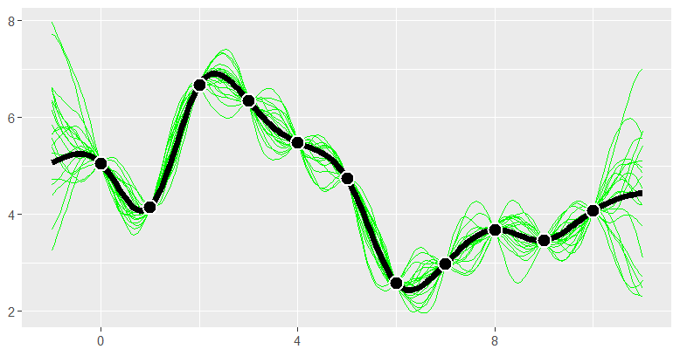
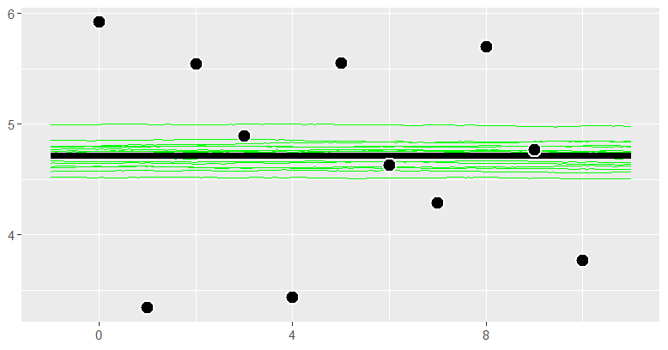
Wild-type, Placebo
GL-XIB
GL-CDZ
The gene expression increased first and then decreased, and the effect was the best is about 7 when the concentration is about 2.
The Gene expression is unstable with changes in concentration, difficult to predict, average is 4.7.

Slide 3
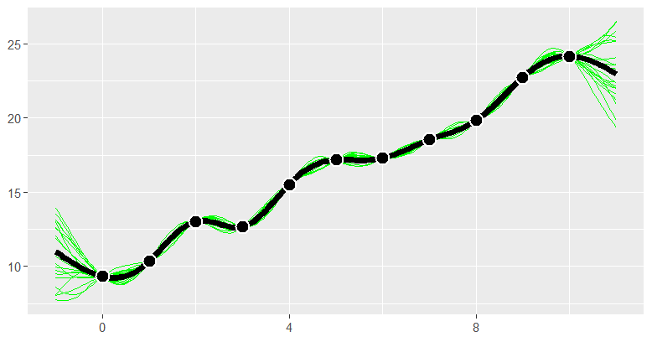
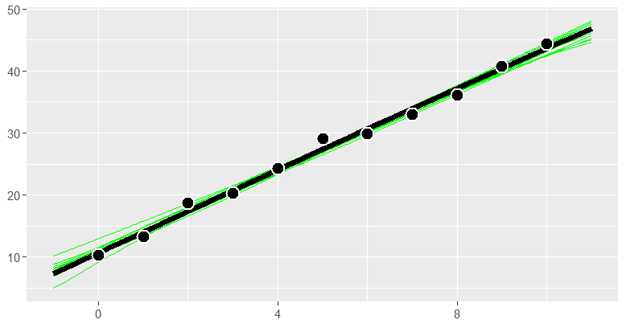
Wild-type, Activating factor 42
GL-RJS
GL-XIK
The gene expression increased with the increase of concentration, and the highest effect is about 28.5.
The gene expression increased with the increase of concentration, and the highest effect is about 44.5.

Slide 4
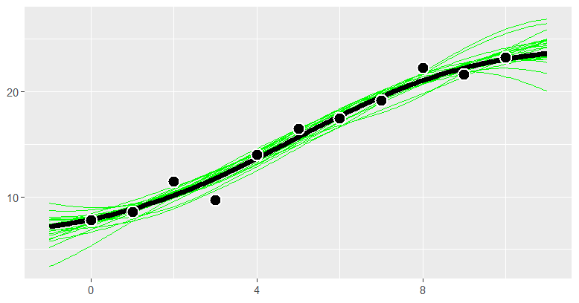
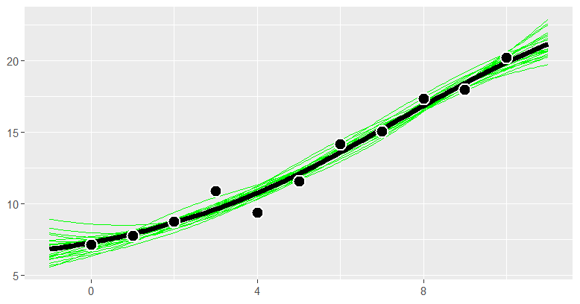
Cell-type, Placebo
GL-CWN
GL-KYH
The gene expression increased with the increase of concentration, and the highest effect is about 23.
The gene expression increased with the increase of concentration, and the highest effect is about 20.

Slide 5
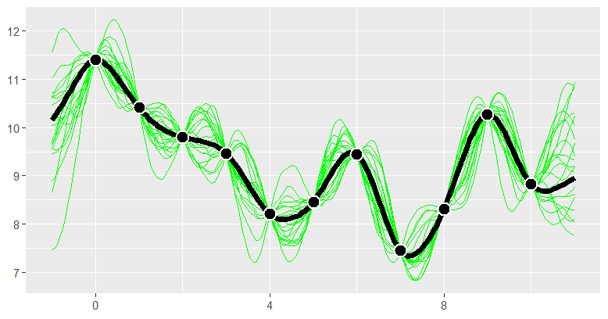
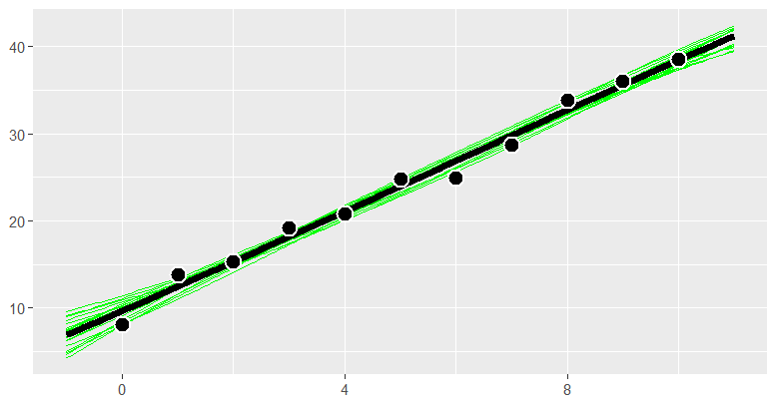
Cell-type, Activating factor 42
GL-ZHW
GL-MFA
The gene expression decreased first and then fluctuated, and the best effect was 11.4 when the concentration was about 0.
The gene expression increased with the increase of concentration, and the highest effect is about 38.5.

